Slide 1

Data Structures
Lecture: Binary Search Tree
By
Nitish Kumar
Asst. Professor,
Lovely Professional University, Punjab

Slide 2
What is a Binary Tree
A binary tree is a a collection of nodes that consists of the root and other subsets to the root points, which are called the left and right subtrees.
Every parent node on a binary tree can have up to two child nodes (roots of the two subtrees); any more children and it becomes a general tree.
A node that has no children is called a leaf node.

Slide 3
A Few Terms Regarding Binary Trees
A
B
C
D
E
F
A is the root
B and C are A’s children
A is B’s parent
B & C are the root of two subtrees
D, E, and G are leaves
G

Slide 4
This is NOT A Binary Tree
A
B
C
D
E
F
G
H
This is a general tree because C has three child nodes

Slide 5
This is NOT A Binary Tree
A
B
C
D
E
F
G
This is a graph
because A, B, E, H, F and C
form a circuit
H

Slide 6
Tree Traversal
There are three common ways to traverse a tree:
  Preorder: Visit the root, traverse the left subtree (preorder) and then traverse the right subtree (preorder)
  Postorder: Traverse the left subtree (postorder), traverse the right subtree (postorder) and then visit the root.
  Inorder: Traverse the left subtree (in order), visit the root and the traverse the right subtree (in order).

Slide 7
Tree Traversals: An Example
A
B
C
D
E
F
Preorder: ABDECFG
Postorder: DEBGFCA
In Order: DBEAFGC
G

Slide 8
Tree Traversals: An Example
A
B
C
D
E
F
Preorder: A
(visit each node as your reach it)
G

Slide 9
Tree Traversals: An Example
A
B
C
D
E
F
Preorder: AB
(visit each node as your reach it)
G

Slide 10
Tree Traversals: An Example
A
B
C
D
E
F
Preorder: ABD
(visit each node as your reach it)
G

Slide 11
Tree Traversals: An Example
A
B
C
D
E
F
Preorder: ABDE
(visit each node as your reach it)
G

Slide 12
Tree Traversals: An Example
A
B
C
D
E
F
Preorder: ABDEC
(visit each node as your reach it)
G

Slide 13
Tree Traversals: An Example
A
B
C
D
E
F
Preorder: ABDECF
(visit each node as your reach it)
G

Slide 14
Tree Traversals: An Example
A
B
C
D
E
F
Preorder: ABDECFG
(visit each node as your reach it)
G

Slide 15
Tree Traversals: An Example
A
B
C
D
E
F
Postorder:
G

Slide 16
Tree Traversals: An Example
A
B
C
D
E
F
Postorder:
G

Slide 17
Tree Traversals: An Example
A
B
C
D
E
F
Postorder: D
G

Slide 18
Tree Traversals: An Example
A
B
C
D
E
F
Postorder: DE
G

Slide 19
Tree Traversals: An Example
A
B
C
D
E
F
Postorder: DEB
G

Slide 20
Tree Traversals: An Example
A
B
C
D
E
F
Postorder: DEB
G

Slide 21
Tree Traversals: An Example
A
B
C
D
E
F
Postorder: DEB
G

Slide 22
Tree Traversals: An Example
A
B
C
D
E
F
Postorder: DEBG
G

Slide 23
Tree Traversals: An Example
A
B
C
D
E
F
Postorder: DEBGF
G

Slide 24
Tree Traversals: An Example
A
B
C
D
E
F
Postorder: DEBGFC
G

Slide 25
Tree Traversals: An Example
A
B
C
D
E
F
Postorder: DEBGFCA
G

Slide 26
Tree Traversals: An Example
A
B
C
D
E
F
In Order:
G

Slide 27
Tree Traversals: An Example
A
B
C
D
E
F
In Order:
G

Slide 28
Tree Traversals: An Example
A
B
C
D
E
F
In Order: D
G

Slide 29
Tree Traversals: An Example
A
B
C
D
E
F
In Order: DB
G

Slide 30
Tree Traversals: An Example
A
B
C
D
E
F
In Order: DBE
G

Slide 31
Tree Traversals: An Example
A
B
C
D
E
F
In Order: DBEA
G

Slide 32
Tree Traversals: An Example
A
B
C
D
E
F
In Order: DBEA
G

Slide 33
Tree Traversals: An Example
A
B
C
D
E
F
In Order: DBEAF
G

Slide 34
Tree Traversals: An Example
A
B
C
D
E
F
In Order: DBEAFG
G

Slide 35
Tree Traversals: An Example
A
B
C
D
E
F
In Order: DBEAFGC
G

Slide 36
Tree Traversals: An Example
A
B
C
D
E
F
Preorder: ABDECFG
Postorder: DEBGFCA
In Order: DBEAFGC
G

Slide 37
Tree Traversals: Another Example
A
B
C
D
E
G
F
Preorder: ABDFHIECG
Postorder: HIFDEBGCA
In Order: DHFIBEACG
H
I

Slide 38
Tree Traversals: Another Example
A
B
C
D
E
G
F
Preorder: A
H
I

Slide 39
Tree Traversals: Another Example
A
B
C
D
E
G
F
Preorder: AB
H
I

Slide 40
Tree Traversals: Another Example
A
B
C
D
E
G
F
Preorder: ABD
H
I

Slide 41
Tree Traversals: Another Example
A
B
C
D
E
G
F
Preorder: ABDF
H
I

Slide 42
Tree Traversals: Another Example
A
B
C
D
E
G
F
Preorder: ABDFH
H
I

Slide 43
Tree Traversals: Another Example
A
B
C
D
E
G
F
Preorder: ABDFHI
H
I

Slide 44
Tree Traversals: Another Example
A
B
C
D
E
G
F
Preorder: ABDFHIE
H
I

Slide 45
Tree Traversals: Another Example
A
B
C
D
E
G
F
Preorder: ABDFHIEC
H
I

Slide 46
Tree Traversals: Another Example
A
B
C
D
E
G
F
Preorder: ABDFHIECG
H
I

Slide 47
Tree Traversals: Another Example
A
B
C
D
E
G
F
Postorder:
H
I

Slide 48
Tree Traversals: Another Example
A
B
C
D
E
G
F
Postorder:
H
I

Slide 49
Tree Traversals: Another Example
A
B
C
D
E
G
F
Postorder:
H
I

Slide 50
Tree Traversals: Another Example
A
B
C
D
E
G
F
Postorder:
H
I

Slide 51
Tree Traversals: Another Example
A
B
C
D
E
G
F
Postorder: H
H
I

Slide 52
Tree Traversals: Another Example
A
B
C
D
E
G
F
Postorder: HI
H
I

Slide 53
Tree Traversals: Another Example
A
B
C
D
E
G
F
Postorder: HIF
H
I

Slide 54
Tree Traversals: Another Example
A
B
C
D
E
G
F
Postorder: HIFD
H
I

Slide 55
Tree Traversals: Another Example
A
B
C
D
E
G
F
Postorder: HIFDE
H
I

Slide 56
Tree Traversals: Another Example
A
B
C
D
E
G
F
Postorder: HIFDEB
H
I

Slide 57
Tree Traversals: Another Example
A
B
C
D
E
G
F
Postorder: HIFDEB
H
I

Slide 58
Tree Traversals: Another Example
A
B
C
D
E
G
F
Postorder: HIFDEBG
H
I

Slide 59
Tree Traversals: Another Example
A
B
C
D
E
G
F
Postorder: HIFDEBGC
H
I

Slide 60
Tree Traversals: Another Example
A
B
C
D
E
G
F
Postorder: HIFDEBGCA
H
I

Slide 61
Tree Traversals: Another Example
A
B
C
D
E
G
F
In Order:
H
I

Slide 62
Tree Traversals: Another Example
A
B
C
D
E
G
F
In Order:
H
I

Slide 63
Tree Traversals: Another Example
A
B
C
D
E
G
F
In Order: D
H
I

Slide 64
Tree Traversals: Another Example
A
B
C
D
E
G
F
In Order: D
H
I

Slide 65
Tree Traversals: Another Example
A
B
C
D
E
G
F
In Order: DH
H
I

Slide 66
Tree Traversals: Another Example
A
B
C
D
E
G
F
In Order: DHF
H
I

Slide 67
Tree Traversals: Another Example
A
B
C
D
E
G
F
In Order: DHFI
H
I

Slide 68
Tree Traversals: Another Example
A
B
C
D
E
G
F
In Order: DHFIB
H
I

Slide 69
Tree Traversals: Another Example
A
B
C
D
E
G
F
In Order: DHFIBE
H
I

Slide 70
Tree Traversals: Another Example
A
B
C
D
E
G
F
In Order: DHFIBEA
H
I

Slide 71
Tree Traversals: Another Example
A
B
C
D
E
G
F
In Order: DHFIBEAC
H
I

Slide 72
Tree Traversals: Another Example
A
B
C
D
E
G
F
In Order: DHFIBEACG
H
I

Slide 73
Tree Traversals: Another Example
A
B
C
D
E
G
F
Preorder: ABDFHIECG
Postorder: HIFDEBGCA
In Order: DHFIBEACG
H
I

Slide 74
A Binary Search Tree is a binary tree with the following properties:
All items in the left subtree are less than the root.
All items in the right subtree are greater or equal to the root.
Each subtree is itself a binary search tree.

Slide 75
Basic Concepts
Binary search trees provide an excellent structure for searching a list and at the same time for inserting and deleting data into the list.

Slide 76
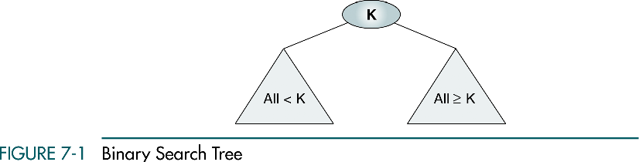

Slide 77
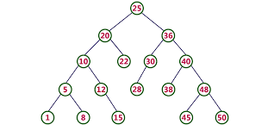

Slide 78
BST Operations
We discuss four basic BST operations: traversal, search, insert, and delete; and develop algorithms for searches, insertion, and deletion.
Traversal
Search
Insertion
Deletion

Slide 79
Searching and inserting in Binary Search Tree
FIND (INFO, LEFT, RIGHT, ROOT, ITEM, LOC, PAR )
If ROOT = NULL, then Set LOC = NULL and PAR = NULL and return
If ITEM = INFO[ROOT], then Set LOC = ROOT and PAR = NULL and return
If ITEM < INFO[ROOT], then:
  Set PTR = LEFT[ROOT] and SAVE = ROOT
Else
  Set PTR = RIGHT[ROOT] and SAVE = ROOT
Repeat step 5 and 6 while PTR != NULL
If ITEM = INFO[PTR], then Set LOC = PTR and PAR = SAVE and return
If ITEM < INFO[PTR], then:
  Set SAVE = PTR and PTR = LEFT[PTR]
Else
Set SAVE = PTR and PTR = RIGHT[PTR]
Set LOC = NULL and PAR = SAVE
Exit
Notes:
목차
자바의 생성배경
자바를 사용하는 이유
과거, 현재, 미래의 자바
자바의 발전과정
버전별 JDK에 대한 설명
자바와 C++의 차이점
자바의 성능
자바 관련 산업(?)의 경향

Slide 80
INSBST (INFO, LEFT, RIGHT, ROOT, AVAIL, ITEM, LOC)
Call FIND (INFO, LEFT, RIGHT, ROOT, ITEM, LOC, PAR )
If LOC != NULL then Exit
[copy item into new node]
  If AVAIL = NULL then write OVERFLOW and Exit
  Set NEW = AVAIL, AVAIL = LEFT [AVAIL] and INFO[NEW] = ITEM
  LEFT[NEW] = NULL and ROGHT[NEW] = NULL
[Add item to tree]
  If PAR = NULL then:
  Set ROOT = NEW
  Else if ITEM < INFO[PAR] then
Set LEFT[PAR] = NEW
Else
Set RIGHT[PAR] = NEW
Exit
Notes:
목차
자바의 생성배경
자바를 사용하는 이유
과거, 현재, 미래의 자바
자바의 발전과정
버전별 JDK에 대한 설명
자바와 C++의 차이점
자바의 성능
자바 관련 산업(?)의 경향

Slide 81
Deletion in Binary Search Tree
CASEA(INFO, LEFT, RIGHT, ROOT, LOC, PAR )
If LEFT[LOC] = NULL and RIGHT[LOC] = NULL then:
  Set CHILD = NULL
Else If LEFT[LOC] != NULL then:
  Set CHILD = LEFT[LOC]
  Else
  Set CHILD = RIGHT[LOC]
If PAR != NULL then
If LOC =LEFT[PAR] then
  Set LEFT[PAR] = CHILD
  Else
  Set RIGHT[PAR] = CHILD
  Else
  Set ROOT = CHILD
Return
Notes:
목차
자바의 생성배경
자바를 사용하는 이유
과거, 현재, 미래의 자바
자바의 발전과정
버전별 JDK에 대한 설명
자바와 C++의 차이점
자바의 성능
자바 관련 산업(?)의 경향

Slide 82
CASEB(INFO, LEFT, RIGHT, ROOT, LOC, PAR )
(a) Set PTR = RIGHT[LOC] and SAVE = LOC
  (b) Repeat while LEFT[PTR] != NULL
    Set SAVE = PTR and PTR = LEFT[PTR]
    (c) Set SUC = PTR and PARSUC = SAVE
Call CASEA(INFO, LEFT, RIGHT, ROOT, SUC, PARSUC)
(a) If PAR != NULL then
If LOC =LEFT[PAR] then
  Set LEFT[PAR] = SUC
  Else
  Set RIGHT[PAR] = SUC
  Else
  Set ROOT = SUC
  (b) Set LEFT[SUC] = LEFT[LOC] and
  RIGHT[SUC] = RIGHT[LOC]
Return
Notes:
목차
자바의 생성배경
자바를 사용하는 이유
과거, 현재, 미래의 자바
자바의 발전과정
버전별 JDK에 대한 설명
자바와 C++의 차이점
자바의 성능
자바 관련 산업(?)의 경향

Slide 83
DEL(INFO, LEFT, RIGHT, ROOT, AVAIL, ITEM)
Call FIND(INFO, LEFT, RIGHT, ROOT, ITEM, LOC, PAR)
If LOC = NULL then Write ITEM not in tree, and Exit
If RIGHT[LOC] != NULL and LEFT[LOC] != NULL then
Call CASEB (INFO, LEFT, RIGHT, ROOT, LOC, PAR)
Else
Call CASEA (INFO, LEFT, RIGHT, ROOT, LOC, PAR)
Set LEFT[LOC] =AVAIL and AVAIL = LOC
Exit.
Notes:
목차
자바의 생성배경
자바를 사용하는 이유
과거, 현재, 미래의 자바
자바의 발전과정
버전별 JDK에 대한 설명
자바와 C++의 차이점
자바의 성능
자바 관련 산업(?)의 경향

Slide 84
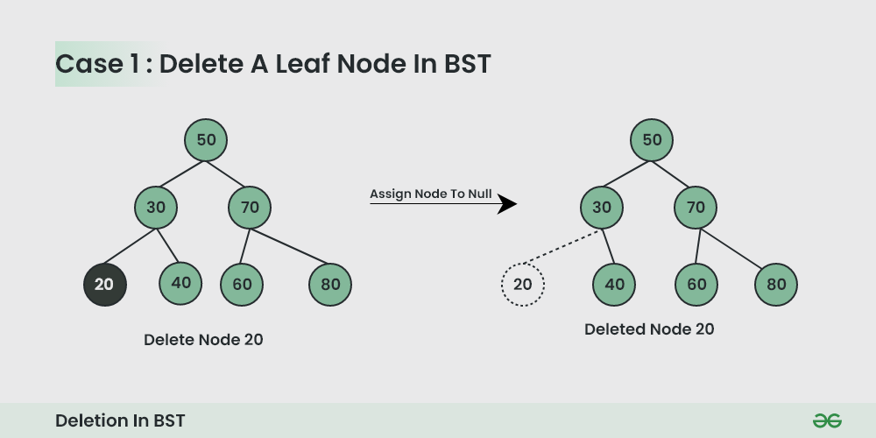
Case 1. Delete a Leaf Node in BST

Slide 85
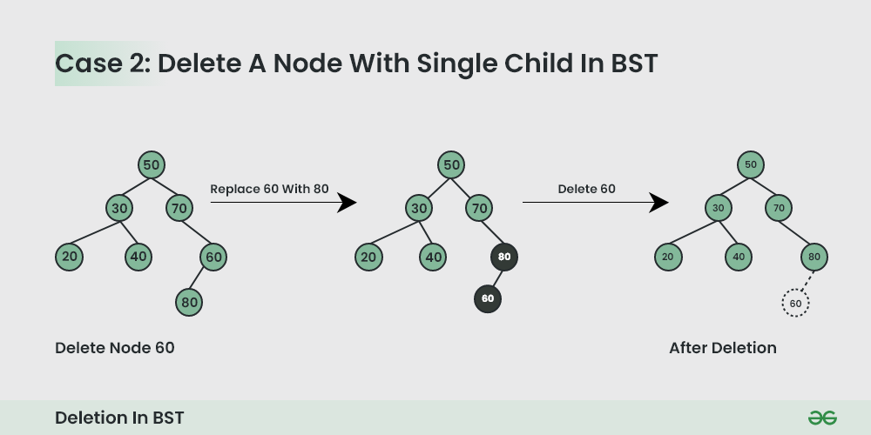
Case 2. Delete a Node with Single Child in BST

Slide 86
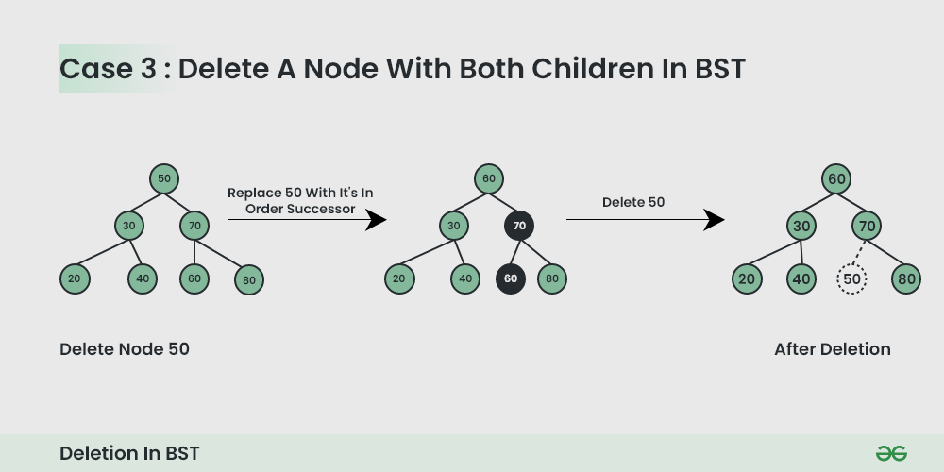
Case 3. Delete a Node with Both Children in BST

Slide 87
struct node* search(int data){
struct node *current = root;
printf("Visiting elements: ");
while(current->data != data){
if(current != NULL) {
printf("%d ",current->data);
//go to left tree
if(current->data > data){
current = current->leftChild;
}//else go to right tree
else {
current = current->rightChild;
}
//not found
if(current == NULL){
return NULL;
}
}
}
return current;

Slide 88
void insert(int data) {
struct node *tempNode = (struct node*) malloc(sizeof(struct node));
struct node *current;
struct node *parent;
tempNode->data = data;
tempNode->leftChild = NULL;
tempNode->rightChild = NULL;
//if tree is empty
if(root == NULL) {
root = tempNode;
} else {
current = root;
parent = NULL;
while(1) {
parent = current;
//go to left of the tree
if(data < parent->data) {
current = current->leftChild;
//insert to the left
if(current == NULL) {
parent->leftChild = tempNode;
return;
}
}//go to right of the tree
else {
current = current->rightChild;
//insert to the right
if(current == NULL) {
parent->rightChild = tempNode;
return;
}
}
}
}
}

Slide 89

Questions

